Slide 1
COMP 2310 Data Structures and Algorithms
Lecture 13
Data Storage Basics

Slide 2
Data Processing
Where the data is stored and how to access it?
Data processing from a computer science perspective:
Storage of data
Organization of data
Retrieval (Access) of data
Processing of data

Slide 3

By the end of 2022, there will be ~97 zettabytes of data in the world

Slide 4
Mili, Micro, Nano...
Frequently used time measures in data transfer: Name Abbr. Value Milisecond msec 10^-3 sec. Microsecond µsec 10^-3 msec. Nanosecond nsec 10^-3 µsec.
→1 msec = 0.001 sec →1 µsec = 0.001 msec = 0.000001 sec →1 nsec = 10^-9 sec

Slide 5
The World In Bytes
How many bytes are required ?
A single text character 1 B A typical text word 10 B A typewritten page 2 KB A low-resolution photograph 100 KB A high-resolution photograph 2 MB
One meter of shelved books 100 MB A pickup truck filled with books 10 GB An academic research library 5 TB
Data stored in Google data centers 12 EB

Slide 6
Data Hierarcy
Character: A character is the smallest unit of information. It includes letters, digits and special characters such as; +, -, = *, %, &, etc.
Field: A field is made up of characters, or simply defined as a combination of characters. It’s an attribute that can be assigned values.
Example: First name, Age, Gender, Date of birth, etc.
Record: Record is the collection of organized and related fields.
File: File is the collection of organized and related records.
Database: Is the collection of organized and related files.
Data warehouse: the collection of related files and databases.
But, every object above is always a sequence of bits!

Slide 7
Data example: Student record
Data for a student is a record of fields:
struct Student {
char name[20];
char SID[10];
char address[30];
float age;
char GPA; };
Data about n students may be stored in a file.

Slide 8
Computer Architecture: Storage Media
data are manipulated here
Main Memory (RAM) Cache
- type: Semiconductors
- Properties: Fast, expensive, volatile, small
data transfer
Secondary Stotage (Magnetic and optical disks) cheap, stable, large
Tertiary Storage (CD, USB...)
Slower, stable,
Cheaper, large
data are stored here
Secolndary Storage

Slide 9
Storage Media: Primary
Cache – fastest and most costly form of storage; volatile; managed by the computer system hardware.
Main memory:
fast access (in nanoseconds);
generally too small / too expensive to store large files
Capacities of 8-64 gigabytes are widely used currently
Capacities have gone up and per-byte costs have decreased steadily and rapidly
Volatile — contents of main memory are usually lost if a power failure or system crash occurs.

Slide 10
Storage Media: Secondary
Magnetic-disk
Data is stored on spinning disks, and read/written magnetically
Primary medium for the long-term storage of data; can store large volumes of data.
Data must be moved from disk to main memory for access, and written back for storage
Much slower access than main memory
direct-access – possible to read data on disk in any order
Capacities range around a few TB currently
Much larger capacity and lower cost/byte than main/flash memory
Growing constantly and rapidly with technology improvements
Non-volatile: Survives power failures and system crashes
disk failure can destroy data, but is rare

Slide 11
Storage Media: Tertiary
Tape storage
non-volatile, used primarily for backup (to recover from disk failure), and for archival data
sequential-access – much slower than disk
very high capacities
tape can be removed from drive ⇒ storage costs much cheaper than disk, but drives are expensive
Tape jukeboxes available for storing massive amounts of data
hundreds of terabytes to even petabytes

Slide 12
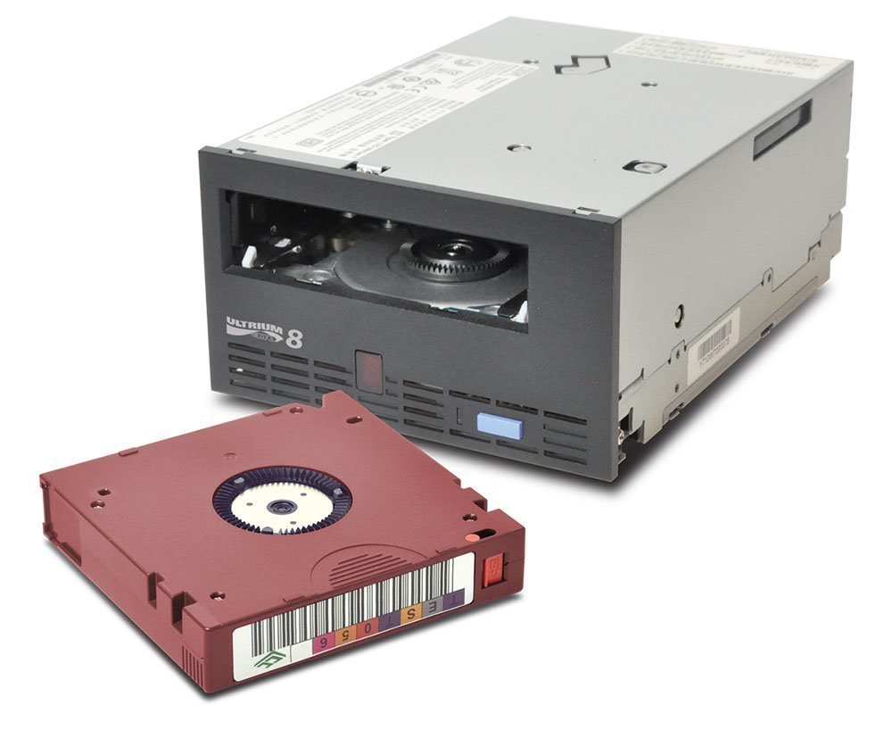
LTO-12: 192 TB capacity Tape System ( 480 TB compressed)

Slide 13
Tape Capacity Record
IBM Sets New Capacity Record For Tape At 580 TB (December 2020)
580 TB is equivalent to 786,977 CDs stacked 3100 ft (944 mt) high, which is taller than Burj Khalifa, the world’s tallest building.
That’s a huge amount of data! All fitting on a tape cartridge on the palm of your hand!

Slide 14
Storage Media: Solid State
A new form of storage that is designed to replace hard drives.
Rather than a magnetic disk to store data, the solid state uses semiconductor flash memory modules.
They offer higher data transfer rates than hard drives, consume much less energy and have no moving parts.
These attributes make them extremely attractive for mobile computers but they are also starting to make their way into high performance desktops as well.
But the overall capacity is still significantly less than what can be achieved with traditional hard drives.

Slide 15
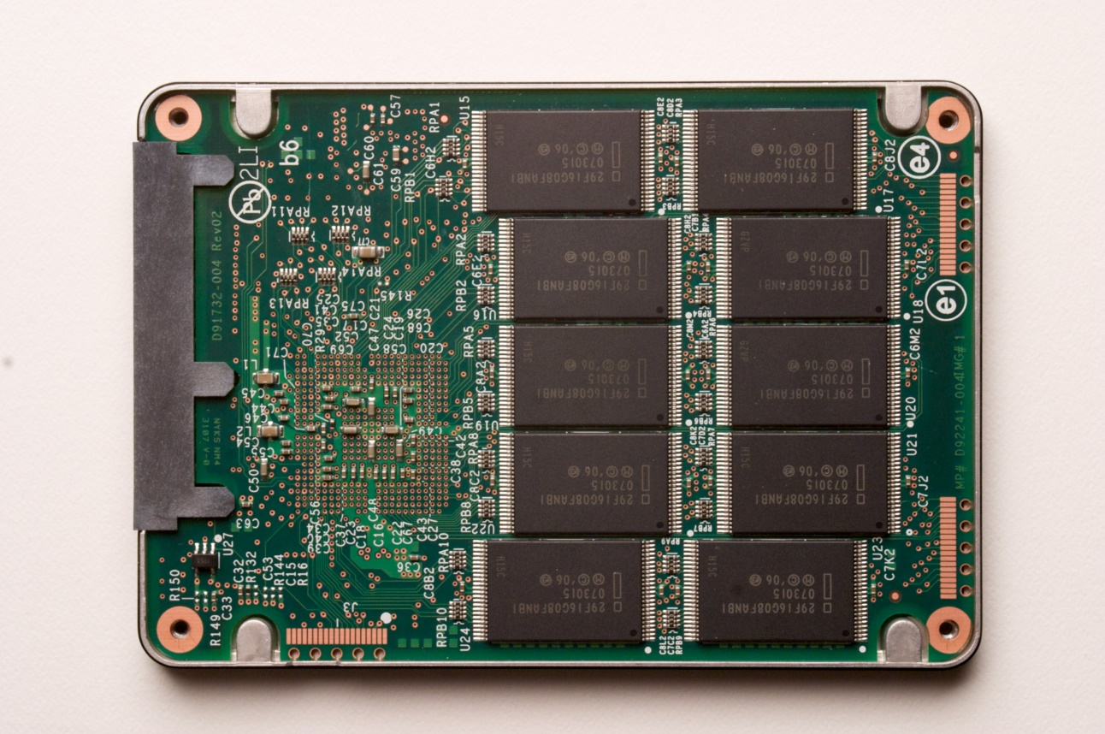
Solid State Drives
NAND flash memory-based drives
High voltage is able to change the configuration of a floating-gate transistor
State of the transistor interpreted as binary data
Data is striped across all chips
Flash memory chip

Slide 16
SSD layout
In contrast to the hard disk, a SSD consists of semiconductor memory building blocks.
It contains no mechanical parts. The smallest unit of an SSD is a page, which is composed of several memory cells, and is usually 4 KB in size.
Several pages on the SSD form a block. A block is the smallest unit of access on a SSD.
Currently, 128 pages are mostly combined into one block; therefore, a block contains 512 KB.
Bigger block sizes are possible as powers of 2: 1KB,
2KB,…

Slide 17
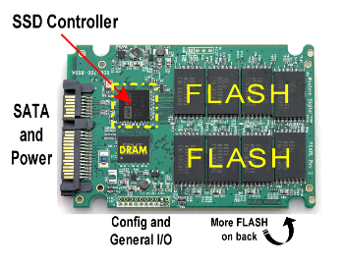
SSD Controller
SSD controller is an embedded microchip (such as CPU in the computer), whose function is like a command center.
It handles all the operation requests of SSD:
reading and writing data
executing garbage collection
guarantee the speed and cleanliness of SSD

Slide 18
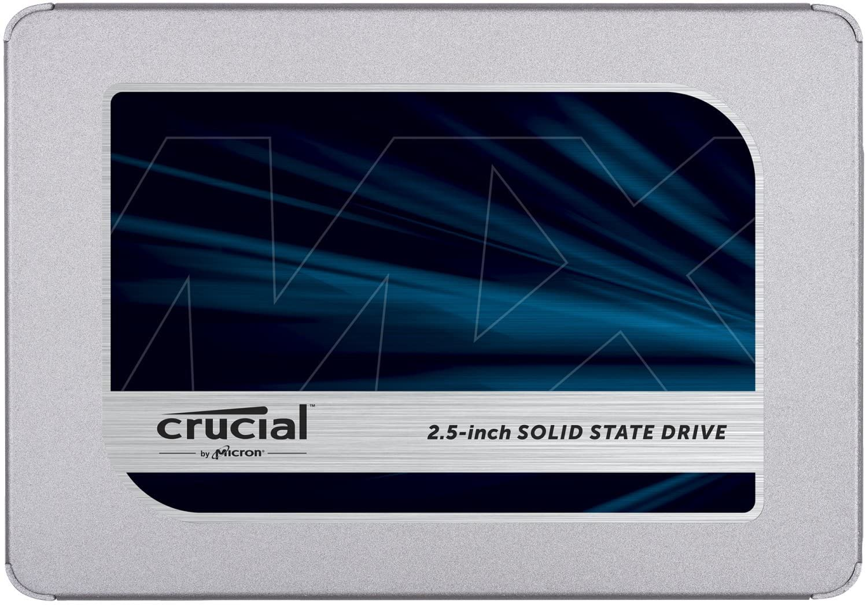
Solid State Drive Example
Crucial MX500 1TB 3D NAND SATA 2.5 Inch Internal SSD, up to 560MB/s.Price ~ $100.

Slide 19
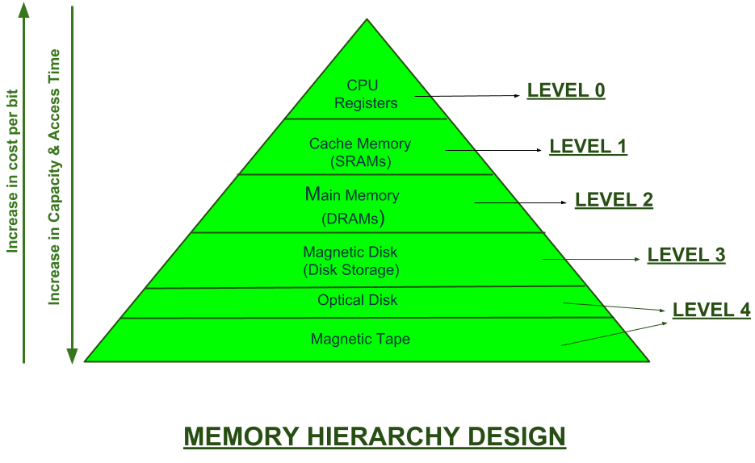
Storage Hierarchy

Slide 20
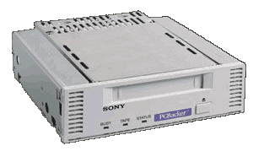
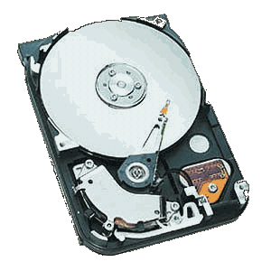
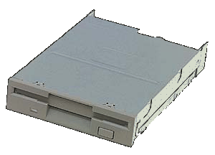
Sequential vs. Random Access Storage
Tape Drive – sequential storage
Floppy Disk Drive – random-access storage
Hard Disk – random-access storage
Sequential – Storage devices that read and write data in a serial (one after the other) fashion
Random-Access – Storage devices that read and write data without going through a sequence of locations

Slide 21
Magnetic Disks
Bits of data (0’s and 1’s) are stored on circular magnetic platters called disks.
A disk head reads and writes bits of data as they pass under the head
Often several platters are organized into a disk pack
They have very high capacity (about 1000 times more than RAM)
Much cheaper than RAM (~40 times cheaper per Megabyte)
In a typical computer, the hard disk drive is used to store the operating system, application programs and user data.

Slide 22
Storage System Characteristics
Storage system specifications are based on parameters about: 1.Storage capacities 2.Access Times 3.Data Transfer rates 4.Reliability: Failure and error rates.

Slide 23
Hard Disk Organization: Physical
Disks are direct access storage devices
A disk is composed of a disk assembly and a head assembly
A disk assembly is a collection of one or more platters with a common spindle (axle)
A head assembly consists of several disk arms ending in disk heads
The arm can move outwards or inwards towards the spindle
Information is stored on the surface of the platters

Slide 24
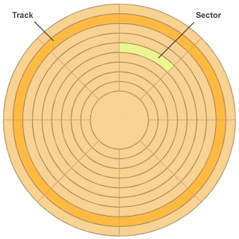
Tracks and sectors on a surface

Slide 25
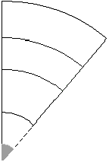
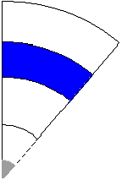
Sector: The “pizza slice”
Track: The green ring
Block: The blue intersection of a track and sector
Block size is a multiple of sector size, (which is fixed) in this example the multiple is one
Cylinder: The yellow “tube”

Slide 26
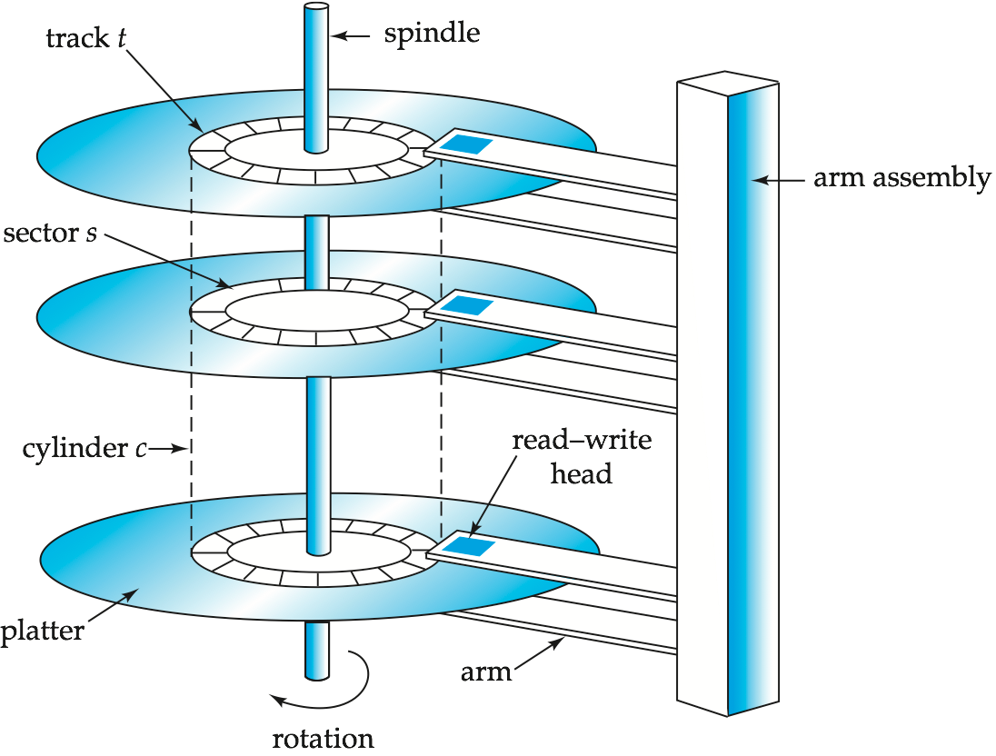
Magnetic Hard Disk Mechanism
Pictures: (Silberschatz,Korth,Sudarshan :Database System Concepts)

Slide 27
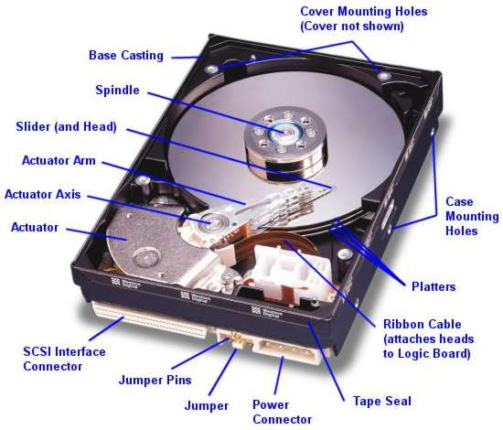

Slide 28
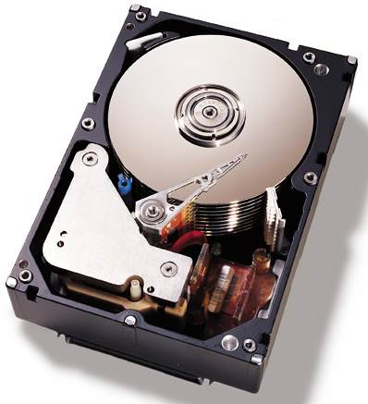
Top view of IBM SCSI server hard disk, with its top cover removed. Note the height of the drive and the 10 stacked platters.
https://www.youtube.com/watch?v=9eMWG3fwiEU

Slide 29
On a Surface...
Each platter has two surfaces to put data
Each surface is divided into tracks (concentric circles)
Each track is divided into sectors
A sector is the smallest addressable unit
Tracks directly above and below one another form a cylinder
Each unit of data is addressed by its track, sector, and surface numbers
e.g. surface 3, track 126, sector 4...

Slide 30
Cylinders
Cylinder: The set of tracks at a given radius of a disk pack → ith tracks on all surfaces: Cylinder i
The number of cylinders = The number of tracks on a single surface.
The set of tracks that can be accessed without moving the disk arm
Moving the disk arm is relatively slow
Once the heads are positioned at a cylinder, data in that cylinder can be accessed more quickly than data in other cylinders
We try to store related data on the same cylinder
(e.g. a file)

Slide 31
Two Cylinders

Slide 32
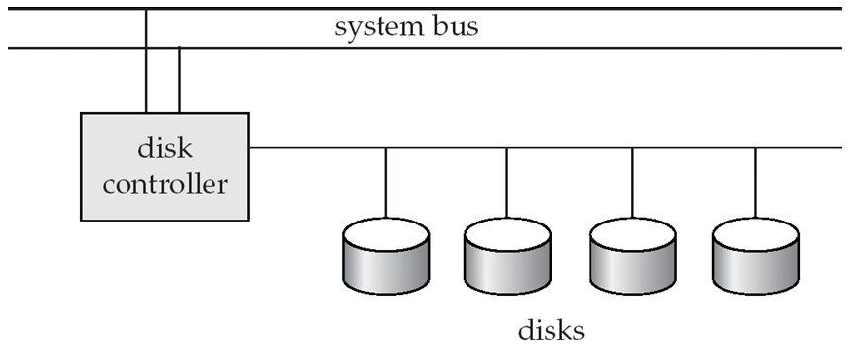
Hard Disk Subsystem
Multiple disks connected to a computer system through a controller
Disk interface standards families
ATA (AT adaptor) range of standards
SATA (Serial ATA)
SCSI (Small Computer System Interconnect) range of standards
Several variants of each standard (different speeds and capabilities)

Slide 33
Hard Disk controller
Disk controller – interfaces between the computer system and the disk drive hardware.
accepts high-level commands to read or write a sector
initiates actions such as moving the disk arm to the right track and actually reading or writing the data
Computes and attaches checksums to each sector to verify that data is read correctly
Ensures successful writing by reading back sector after writing it
The controller has an internal cache (a number of MBs) that it uses to buffer data for read/write requests.
Modern disk controllers are integrated into the disk drive. For example, "SCSI disks" have built-in SCSI controllers.
Some Controller functionality (checksum, bad sector remapping) often carried out by individual disks which reduces load on controller

Slide 34
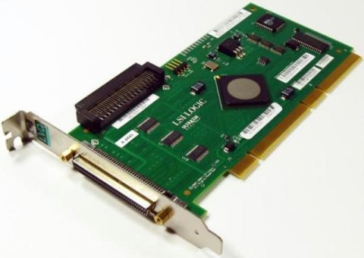
A SCSI PCI-X storage controller card

Slide 35
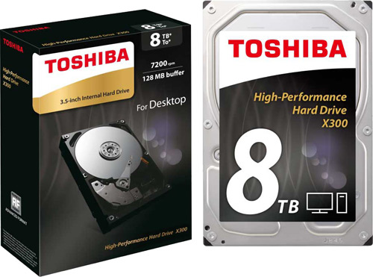
Current Disk Technology Examples
Toshiba X300
Interface: SATA 6Gbps
Capacity: 4 – 10TB
Cache: 128MB
RPM(Speed): 7,200
Seagate BarraCuda
Interface: SATA 6Gbps
Capacity: 2 – 3TB
Cache: 64MB
RPM: 7,200

Slide 36
Performance Measures of Disks
Access time – the time it takes from when a read or write request is issued to when data transfer begins. Consists of:
Seek time – time it takes to reposition the arm over the correct track.
Average seek time is 1/2 the worst case seek time.
4 to 10 milliseconds on typical disks
Rotational delay (Rotational latency) – time it takes for the sector to be accessed to appear under the head.
Average latency is 1/2 of the worst case latency.
4 to 11 milliseconds on typical disks (5400 to 15000 r.p.m.)
Transfer time – the rate at which data can be retrieved from or stored to the disk.
4 to 8 MB per second is typical
Seek time and rotational delay dominate, and we can do some things to help (in the context of databases). Transfer time is less important, and in any case, there is nothing we can really do about it.

Slide 37
Performance Measures (Cont.)
Mean time to failure (MTTF) – the average time the disk is expected to run continuously without any failure.
Typically 3 to 5 years
Probability of failure of new disks is quite low, corresponding to a “theoretical MTTF” of 30,000 to 1,200,000 hours for a new disk
E.g., an MTTF of 1,200,000 hours for a new disk means that given 1000 relatively new disks, on an average one will fail every 1200 hours
MTTF decreases as disk ages!!

Slide 38
Types of Delay With Disks
Long delay
Three types of delay
Rotational Delay
Time to rotate the desired sector to the read head
Related to RPM
Seek delay
Time to move the read head to a different track
Transfer time
Time to read or write bytes
Rotation
11
12
13
10
23
24
25
14
32
9
22
31
33
26
15
8
21
30
34
27
0
7
20
29
35
16
1
28
6
19
17
2
18
5
4
3
Short delay

Slide 39
Disk Access Performance: W/R Times
Given the address, R/W from a disk involves:
1.Seek time -- Position heads to the correct track/cylinder (s)
4 to 10 milliseconds on typical disks.
2.Rotational latency -- Wait until the required data is under the read/write heads (r)
4 to 8 milliseconds on typical disks
3.Transfer time -- Read/Write time of the required data (t) => Time for data to move under the I/O head.
Total Disk Access Time= Seek Time+Rotational Latency +Transfer Time = s + r + t

Slide 40
Reading and Writing Data
It takes a long time (Relatively) for the disk heads to move to a given track
But once in position, the sectors rotate under the head very fast
Only one head reads/writes at any one time.
Average seek time: ½ worst case time.
Average rotational latency: ½ full rotation time.
Common disk parameter: # of rotations per minute revolution per minute: rpm or RPM Typical values: 5400, 7200,...,15000 rpm

Slide 41
Blocking
Blocking:
Refers to storing a number of records in one block on the disk.
Blocking factor (bfr) refers to the number of records per block.
There may be empty space in a block if an integral number of records do not fit in one block.

Slide 42
Blocking
A sector is the basic physical unit of data storage on a hard disk. Sizes: 512, 1024, 2048, 4096....Bytes
Disk tracks are also divided into logical blocks/Clusters
A block usually holds an integral number of sectors like 2, 4, 8...
Block Transfer time= #sectors in a block * sector Trans. Time
Assume 4 sectors in a block and sector transfer time = 0.04 msec:
Btt= 4*0.04= 0.16 msec.
The # of records that can be stored in a block :
Blocking Factor = ⌊ Block size/Record size ⌋
Ex: Record size 360 B, block size 4KB. Find blocking factor. bf = ⌊ 4096/360 ⌋ = 11

Slide 43
Storage Access
A database file is partitioned into fixed-length storage units called blocks. Blocks are units of both storage allocation and data transfer.
Database system seeks to minimize the number of block transfers between the disk and memory. We can reduce the number of disk accesses by keeping as many blocks as possible in main memory.
Buffer – portion of main memory available to store copies of disk blocks.
Buffer manager – subsystem responsible for allocating buffer space in main memory.
CPU
Buffer
Main Memory
Disk

Slide 44
Reading Data
Disk acces is a very slow operation. Reading or writing a disk block is time consuming because of the seek time and rotational latency.
For this reason, disk system reads/writes an entire block of data at a time, not just a single record or byte
Typically, only one head can read/write at a given time. All heads move together, they are all at the same Radius (On a specific cylinder)
The most important bottleneck in data transfer is the #of disk accesses
→ Should be as few as possible!
Buffering is used to speed up the transfer of contiguous blocks from disk to RAM.

Slide 45
Optimization of Disk-Block Access
Block – a contiguous sequence of sectors from a single track
data is transferred between disk and main memory in blocks (i.e, you can’t ask for a single bit or byte)
Smaller blocks: more transfers from disk
Larger blocks: more space wasted due to partially filled blocks
Typical block sizes today range from 4 to 16 kilobytes
Disk-arm-scheduling algorithms order pending accesses to tracks so that disk arm movement is minimized
elevator algorithm: move disk arm in one direction (from outer to inner tracks or vice versa), processing next request in that direction, till no more requests in that direction, then reverse direction and repeat

Slide 46
Optimization of Disk Block Access
File organization – optimize block access time by organizing the blocks to correspond to how data will be accessed
E.g. Store related information on the same or nearby cylinders.
Files may get fragmented over time
E.g. if data is inserted to/deleted from the file
Or free blocks on disk are scattered, and newly created file has its blocks scattered over the disk
Sequential access to a fragmented file results in increased disk arm movement
Some systems have utilities to defragment the file system, in order to speed up file access

Slide 47
Buffer Manager
Programs call on the buffer manager when they need a block from disk.
If the block is already in the buffer, the requesting program is given the address of the block in main memory
If the block is not in the buffer,
The buffer manager allocates space in the buffer for the block, replacing (throwing out) some other block, if required, to make space for the new block.
The block that is thrown out is written back to disk only if it was modified since the most recent time that it was written to/fetched from the disk.
Once space is allocated in the buffer, the buffer manager reads the block from the disk to the buffer, and passes the address of the block in main memory to requester.

Slide 48
System I/O Buffer
DISK
Data transferred by blocks
RAM
Secondary Storage
(File blocks)
Program
Buffer
Data transferred by records
Temporary storage in RAM for one or more blocks of data

Slide 49
Buffer Management
Data Requests from Higher Levels(Programs)
BUFFER POOL
disk page
free frame
MAIN MEMORY
choice of frame is dictated
by replacement policy
DISK
Notes:
4

Slide 50
Buffer Management
Buffer manager controls main memory.
When a new page is to be placed in the pool:
If request exceed available space, it has to select a buffer to returning its contents to disk.
If buffered block has not been changed, buffer manager erases the block from main memory.
If changed, writes the buffered block to disk.

Slide 51
Hard Disk Fragmentation
When files are deleted, the blocks occupied will be open for writing.
What if the next file which is to be written in the same blocks is larger than the space?
The system has to break the file up into pieces throughout the filesystem
This is called fragmentation. It considerably slows the file access
Most modern filesystems contain automatic defragmentation utilities to compact the storage area.

Slide 52
SSD or Hard Disk ?
Storage requirements are growing exponentially and new technologies are constantly being developed.
Large capacity hard disk drives are popular in data centers, web hosting, cloud backup or cloud storage applications.
Very high disk capacities are expected:
~30TB in 2023.
SSDs are often more suitable for use in portable devices such as smartphones and laptops.
However, SSDs are also rapidly entering data centers and servers as they allow reliable, high storage capacities and higher performance.

